Slide 1
Arthrodiastasis of the Ankle Joint
Dan Preece MS IV
CSPM Class 2009

Slide 2
Osteoarthritis theory: An imbalance between articular cartilage breakdown and repair.
Trauma/overuse loss of cartilage molecules (proteoglycans)
altered mechanical properties
abnormal joint motion
further cartilage damage
chondrocytes attempt to repair damage
chondrocytes dedifferentiate
produce inappropriate matrix molecules such as catabolic cytokines and matrix proteases
further degradation of the cartilage. (4)
4. Buckwalter JA, Mankin HJ. Articular cartilage: tissue design and chondrocyte-matrix interactions. Instr Course Lect 1998;47:477–86.

Slide 3
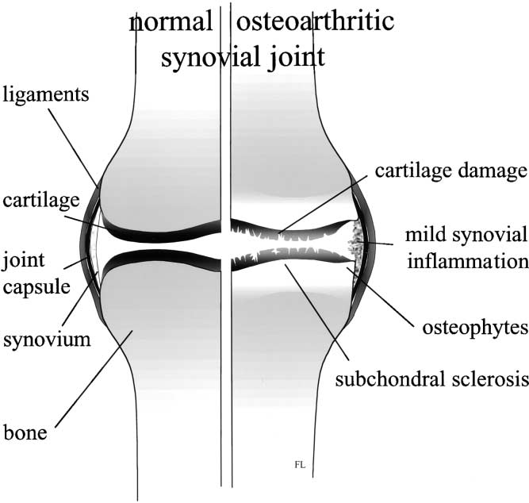
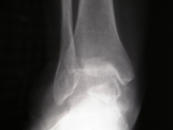
Advanced osteoarthritis of the ankle joint:
joint space narrowing
osteophytosis
subchondral sclerosis and cysts
pain through range of motion
osteochondral defects
joint space osseous and cartilaginous bodies

Slide 4
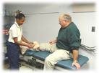
Conservative Tx Options for OA:
activity modification
physical therapy
medications
orthotic devices
footwear modifications

Slide 5
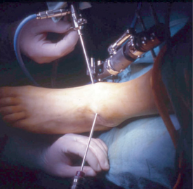
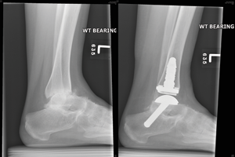
Invasive treatment options for advanced ankle OA:
Viscosupplementation (intra-articular injection of hyaluronan, restoring synovial fluid properties)
Arthroscopy
Arthrodiastasis
Implant Arthroplasty
Tibial Osteotomies
Joint reconstruction with allograft
Joint Fusion
The younger patient (<50-60 y.o. and active) with advanced OA has few effective options that do not involve definitive joint destruction.

Slide 6
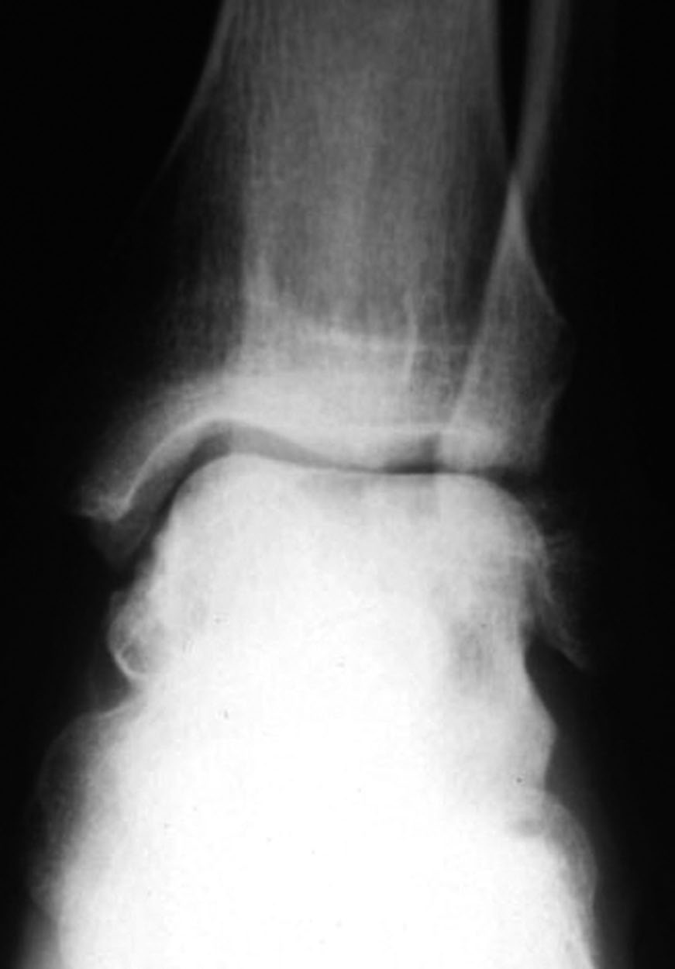
Indications and Contraindications for Arthrodiastasis:
Indications:
congruent joint space
pain through ROM
at least partially mobile
advanced arthritic degeneration
Contraindications:
active infection
advanced coronal plane deformity
significant loss of bone stock
6. Paley D, Lamm BM. Ankle joint distraction. Foot Ankle Clin 2005;10(4):685–98, ix.

Slide 7
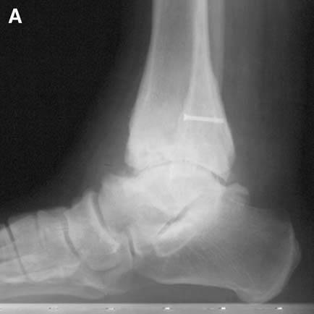
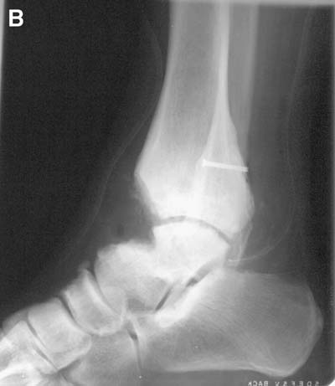
Treatment Method:
Additional measures that may need to be taken prior to distraction include:
athroscopic removal of blocking osteophytes
the release of joint contracture
correction of osseous alignment of the ankle joint

Slide 8
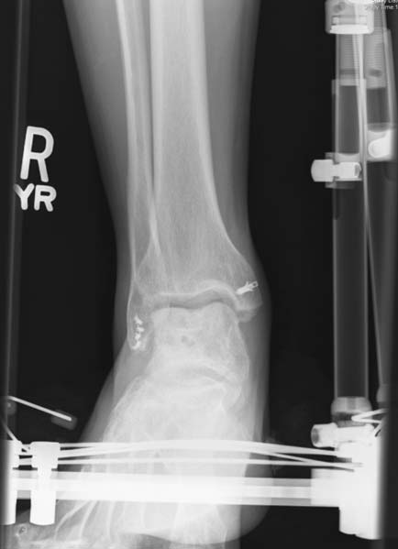
Treatment Method:
External fixation is applied to
the tibia/fibula and foot.
The ankle is distracted approx. 5 mm.
Distraction is maintained for 3 months.
(studies range from 4 weeks to 4 months)
Weight bearing as tolerated is allowed.
A hinge at the ankle joint is often
incorporated in the frame work.

Slide 9
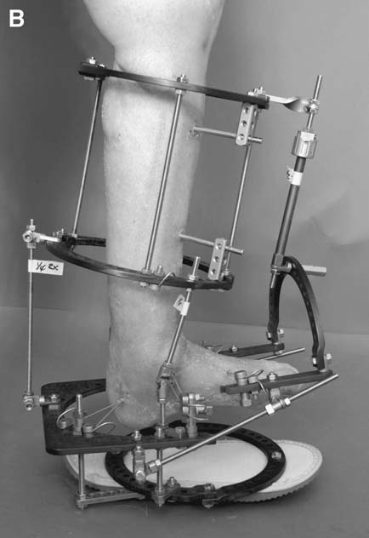
Hinged ankle joint distraction was performed simultaneously with gradual correction of equinus deformity.

Slide 10
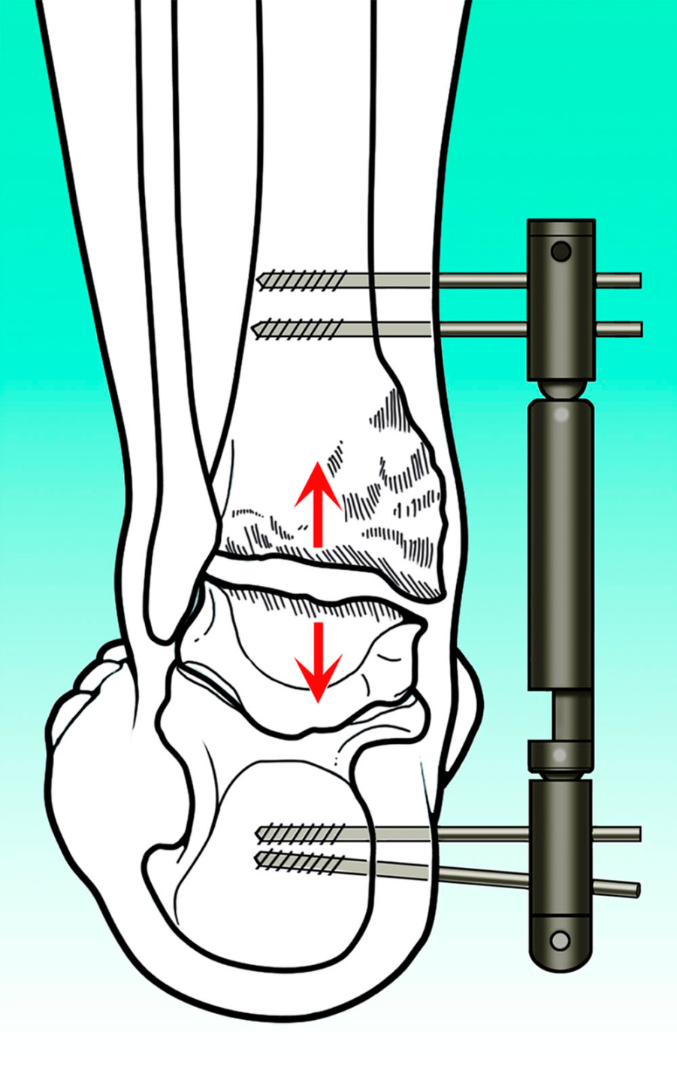
A monolateral hinged ankle external fixator (Orthofix).

Slide 11
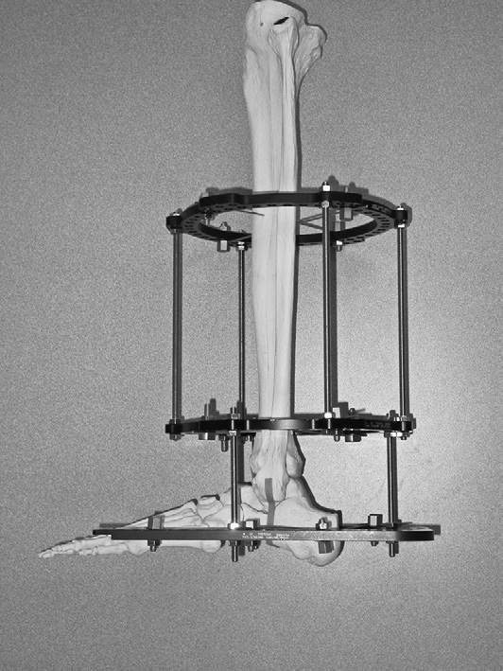

Slide 12
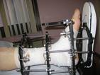
Physiology of Distraction:
Ankle joint distraction combined with weight bearing creates intermittent intra-articular pressure (due to minor flexion of the external fixation pins) that have been to shown to:
Increase proteoglycan synthesis (1)
Decrease the inhibition of proteoglycan synthesis by mononuclear inflammatory cells (2)
Decrease catabolic cytokines, IL-1 and TNF-a.
Increased nutrition delivery to chondrocytes.
1. Lafeber F, Veldhuijzen JP, van Roy JL, Huber-Bruning OH, Bijlsma JW. Intermittent hydrostatic compressive force stimulates exclusively the proteoglycan synthesis of osteoarthritic human cartilage. Br J Rheumatol 1992;31:437– 42.
2. Van Valburg AA, van Roy HL, Lafeber F, Bijlsma JW. Beneficial effects of intermittent fluid
pressure of low physiological magnitude on cartilage and inflammation is osteoarthritis. An in
vitro study. J Rheumatol 1998;25(3):515– 20.

Slide 13
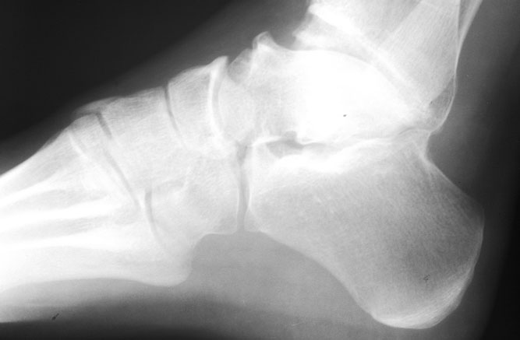
Physiology of Distraction:
Other theorized mechanisms of action (5):
Positive effects on nerve endings
Decreased subchondral sclerosis and therefore better shock absorption.
Stretching of the joint capsule causing decreased joint reactive forces
5. Chiodo CP, McGarvey W. Joint distraction for the treatment of ankle osteoarthritis. Foot
Ankle Clin 2004;9(3):541–53, ix

Slide 14
Studies:
Date / Author | # Pts | Ave f/u Time | Distraction Time | ROM | Pain | Other
1995/Van Valburg | 11 | 20 months | 3 months | 55% of pts | 45% pts were pain free | 50% of pts cartilage thickening 10-20%
1999/Van Valburg | 17 | 2 years | 3 months | 75% of pts showed an | 64% of pts happy with pain levels | statistical in cartilage thickness
2002/Marijnissen | 57 | 2.8 years | 3 months | 69% of pts improved in fxn/rom | 72% of pts pain levels by 38% | All clinical fxns steadily improved to end of study.
2005/Ploegmakers | 22 | 7 years | 3 months | 73% of pts | 73% of pts | 27% required fusions
2007/ Giannini | 12 | 5 years | 4 weeks | 63% of pts | 63% of pts | 33% required fusions
2008/ Paley | 23 | 5.3 years | 4 months | 61% satisfied | 78% able to control with occasional NSAID | 71% would recommend to friends,

Slide 15
2002/Marijnissen et al. (9)
- 17 pts
- ave age 44
- 3 months of distraction / arthroscopic debridement (9 pts) vs debridement alone(8 pts).
**Only study with a control group.
Results: F/u ave. of 1 year.
“Distraction/debridement group” showed 38% improvement in pain scores and 42% improvement in fxn scores which was statistically significant over the debridement group.
3 of the 8 pts in the “debridement only” group did not reach the 1 year mark post-op because of intense pain levels and were later treated with distraction that created acceptable levels of decreased pain and increased fxn for all three pts.

Slide 16
Study Critiques:
Small pt groups
Short follow-up periods for some studies
Few to no control groups (difficult to arrange on ethical grounds)
Few comparative studies with other modalities such as arthroscopy, viscosupplementation, implants etc.
Treatments being rendered differ in:
distraction times
with or w/o arthroscopy
type of frames.

Slide 17
Risks/Difficulties of Arthrodiastasis:
Pin tract/bone/joint infection
Failure to relieve pain/discomfort (20-35%)
Pt non-compliance, unwilling to finish long tx period.
Failure to perform necessary pin care.

Slide 18
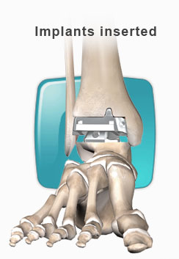
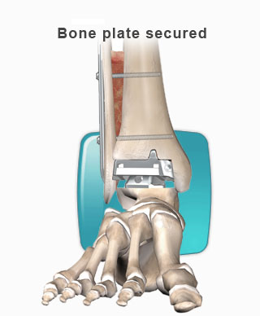
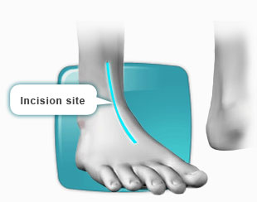
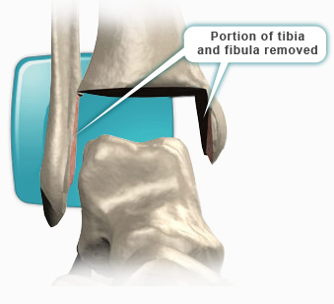
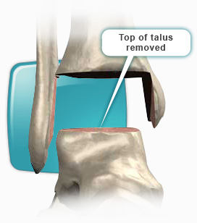
Benefits of Arthrodiastasis:
Non-joint destructive procedure when compared to implants or fusion.
Other methods may still be attempted if this tx fails, “no bridges burned”. Only time of tx is lost.
Few contraindications.
Great alternative choice for young pts with severe OA who do not want definitive surgery.
Myanklereplacement.com

Slide 19
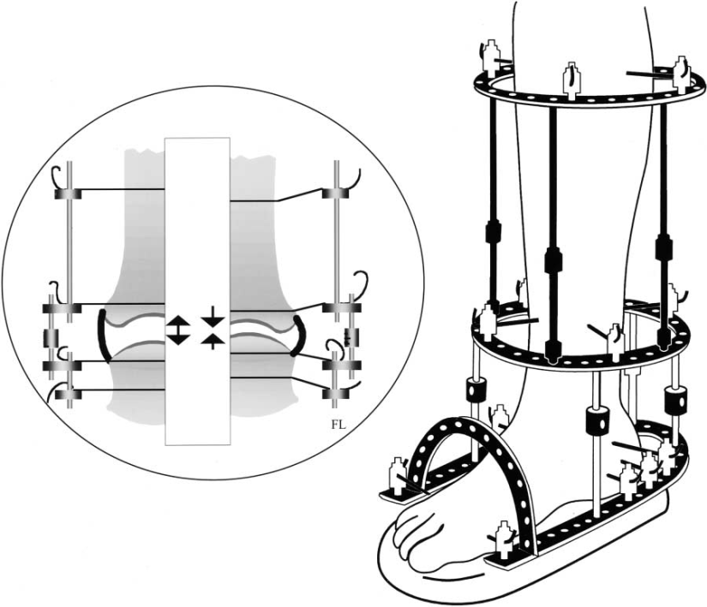
The Future:
Combination Tx of:
arthroscopic debridement
arthrodiastasis
viscosupplementation.

Slide 20
References:
1. Lafeber F, Veldhuijzen JP, van Roy JL, Huber-Bruning OH, Bijlsma JW. Intermittent hydrostatic compressive force stimulates exclusively the proteoglycan synthesis of osteoarthritic human cartilage. Br J Rheumatol 1992;31:437– 42.
2. Van Valburg AA, van Roy HL, Lafeber F, Bijlsma JW. Beneficial effects of intermittent fluid pressure of low physiological magnitude on cartilage and inflammation is osteoarthritis. An in vitro study. J Rheumatol . 1998;25(3):515– 20.
3. Aldegheri R, Trivella G, Saleh M. Articulated distraction of the hip. Conservative surgery for arthritis in young patients. Clin Orthop Relat Res 1994;301:94– 101.
4. Buckwalter JA, Mankin HJ. Articular cartilage: tissue design and chondrocyte-matrix interactions. Instr Course Lect 1998;47:477–86.
5. Chiodo CP, McGarvey W. Joint distraction for the treatment of ankle osteoarthritis. Foot Ankle Clin 2004;9(3):541–53, ix.
6. Paley D, Lamm BM. Ankle joint distraction. Foot Ankle Clin 2005;10(4):685–98, ix.
7. Peter M. van Roermund, MDa, Anne C.A. Marijnissen, PhDb, Floris P.J.G. Lafeber, PhDb . Joint distraction as an alternative for the treatment of osteoarthritis. Foot Ankle Clin N Am 7 (2002). 515– 527.
8. Kenneth R. Morse, MD, A. Samuel Flemister, MD, Judith F. Baumhauer, MD, Benedict F. DiGiovanni, MD. Distraction Arthroplasty. Foot Ankle Clin N Am 12 (2007) 29–39.

Slide 21
Marijnissen AC, Van Roermund PM, Van Melkebeek J, et al. Clinical benefit of joint distraction in the treatment of severe osteoarthritis of the ankle. Arthritis Rheum 2002;46(11): 2893–902.
10. Dror Paley, MD, Bradley M. Lamm, DPM, Rachana, MD. Purohit Distraction Arthroplasty of the Ankle-How Far Can You Stretch the Indications? Foot Ankle Clin N Am 13 (2008) 471–484.
11. van Valburg AA, van Roermund PM, Marijnissen AC, et al. Joint distraction in treatment of osteoarthritis: a two-year follow-up of the ankle. Osteoarthritis Cartilage 1999;7(5):474–9.
12. Ploegmakers JJ, van Roermund PM, van Melkebeek J, et al. Prolonged clinical benefit from joint distraction in the treatment of ankle osteoarthritis. Osteoarthritis Cartilage 2005;13(7): 582–8.
13. S. Giannini, R. Buda, C. Faldini, F. Vannini, M. Romagnoli, G. Grandi and R. Bevoni. J Bone Joint Surg Am. 2007;89:15-28.
14. van Valburg AA, van Roermund PM, Lammens J, et al. Can Ilizarov joint distraction delay the need for an arthrodesis of the ankle? A preliminary report. J Bone Joint Surg 1995;77B:720– 5.

